Slide 1
Academic Reading & Writing
Writing Review for Final Paper

Slide 2

Last Week
Last week we looked at Abstracts and Title Pages
For the final paper you only need a title page

Slide 3
This Week
We’ll focus on some common issues and grammar points to avoid when writing research papers, such as:
Spacing and Punctuation
Register and Language
Comma Splices and Using Conjunctions
Reference & Citation Formats Review

Slide 4
Spacing and Punctuation

Slide 5
Ensuring a Consistent Font
One practice that will help your assignments looks better is to make sure they are in a consistent font (colour, size, etc.)
Sometimes when pasting text copied from another source it will keep that source formatting – make sure to set the same font throughout your whole paper (and make sure it is an English font to get the correct spacing)

Slide 6
Punctuation Spacing
A period, comma, exclamation mark, question mark, colon, or semi-colon has no space before, and one space after (not built into most English fonts)
To end one phrase. Starting another phrase, then the next.
To end one phrase? Starting another phrase! Then the next.
To end one phrase: starting another phrase; then the next.
The first parenthesis has a space before, and the last has one space after.
One phrase (with another in parentheses) and the last part.

Slide 7
Citations Too
(Smith,2000)
(Smith, 2000)

Slide 8
Line spacing
APA calls for double spacing
You want to make sure your whole document has double spacing (you can select all and apply if you need to) so set line spacing to 2.0
Different fonts and different font sizes can also affect line spacing, so make sure all your fonts and sizes are the same (12-point font for APA)

Slide 9
Register and Language

Slide 10
Academic Register
Register is the use of “socially appropriate” language, judged by criteria such as how formal or polite it is
Some phrases, styles, or terms are associated with certain types of register, either spoken or written
Research papers are written in academic registers: language used for writing and speaking in professional academic contexts
There are different ones, but we’ll generalize

Slide 11
Some guidelines for Academic Register
Academic registers:
They aim to inform
They stress precision
They are more formal
They are not playful or entertaining
They do not try to connect with the reader
They try to remain objective

Slide 12
Things to Consider: Passive Voice
Passive voice is very popular due to the need for objectivity and formality
Active voice is useful for stating author positions or explaining who took certain actions or procedures (especially when it is important to know)

Slide 13
Things to Consider: Emotive Language
We want to avoid too much emotive language, which is language intended to affect the emotions of the reader in some way (such as news headlines)
Academic writing is meant to be objective and factual, so we want to minimize emotion when it is not appropriate
Personal pronouns and author opinions should be used carefully to make sure they are objective, or it is important to share subjective info
Emotional and subjective words and expressions should be avoided, so that the reader can make their own conclusions based on the presented facts

Slide 14
Examples of Emotive Language
Adjectives: absolutely, extremely, terrible, awfully, good, shocking, bad, beautiful, perfect, wonderful
For example, instead of saying something is beautiful, which is a subjective opinion, you can mention that it is considered by some/many to be beautiful
Other value judgements are similar – you want to support these claims if you make them (e.g. saying something is excellent – in what way? Says who?)

Slide 15
Emotive Expressions
The company reduced the price of its top-selling product.
The jogger was involved in an altercation with the alleged suspect.
The registration and selection system could be improved in the following ways.
The company slashed the high price of its greatest product.
The innocent jogger was senselessly attacked by the thief.
The excellent registration system could nevertheless benefit from these minor adjustments.

Slide 16
Other guidelines
We also want to avoid contractions when writing
it’s, didn’t, can’t, What’s, Wouldn’t
We should avoid exclamation points (again, to avoid emotive language)
This is a significant conclusion!
Avoid generalizing (always, never, all)
Everyone thinks this way

Slide 17
Other guidelines
We want to avoid conversational/colloquial tones:
“It turns out that it takes more time to complete the study than you might expect.”
“As we all know, ….”
“Of course, this was a complicated method.”
“What’s more, we found interesting results amongst undergraduates.”

Slide 18
Reminder: Repetition
We want to avoid any structures or patterns which stand out to the reader (especially as lists).
As for one… As for two…. As for three…
With regard to
Concerning
As far as…

Slide 19
Besides
Besides has different connotations depending on where it goes in the sentence
Without a comma, at the front or in the middle of a sentence, it often means “Apart from”
Technologically, there are many solutions to the problem of high-speed transport besides airliners.
Besides airlines, there are many technological solutions to the problem of high speed transport.

Slide 20
Besides
Besides has different connotations depending on where it goes in the sentence
With a comma, it adds another reason but almost an unecessary or extra one (often more colloquial tone when used this way) She had exams to study for and work to catch up on. Besides, she didn’t feel like going out anyway.

Slide 21
On the other hand
This introduces another point, but specifically in contrast with one previously described. It does not necessarily need to be used with “on one hand,” but if it is, you can leave off the second “hand”
It’s a clear day with fresh air and sunshine. On the other hand, it is thirty degrees below zero.
On one hand, the price is pretty low. On the other, it might break pretty quickly if we do buy it.

Slide 22
Hedging
Since studies are dealing with new knowledge and often speculating as to theory, hedging language is used to show how confidently a conclusion is known
Certain: X is caused by Y, X is because Y
Probable: X is likely due to Y, X is most probably because Y, it appears that X causes Y, the results suggest X causes Y
Possible: X could lead to Y, X might be the cause of Y, it could be argued that X causes Y

Slide 23
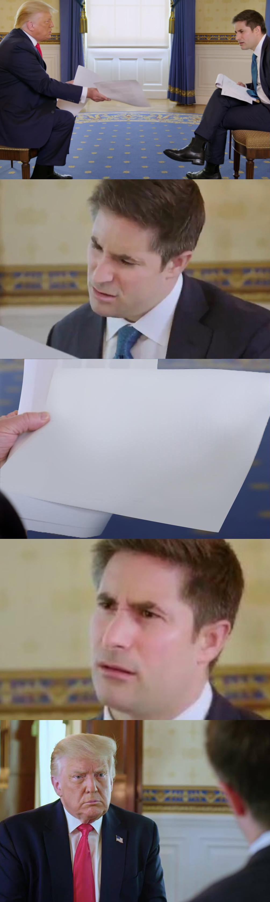
This is not a register for speaking to your friend…
Greetings, my esteemed companion. I am most enthusiastically anticipating our upcoming soiree, and would like to extend to you my warmest regards to you in advance of our meeting.

Slide 24
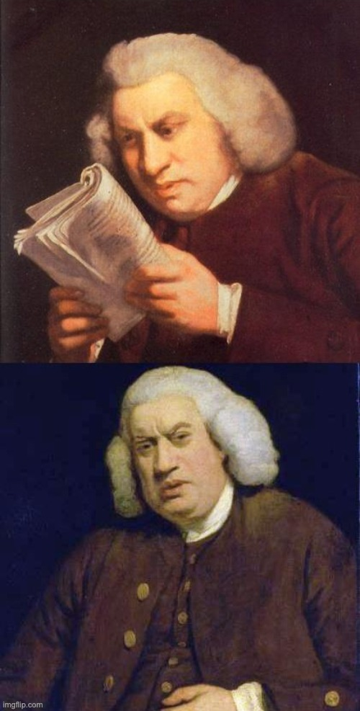
So you do not want to write as if it were
Of course, I really think it would be great if someone could study this in the next little while, because it’s probably going to be really useful and it would be a shame if they didn’t.

Slide 25
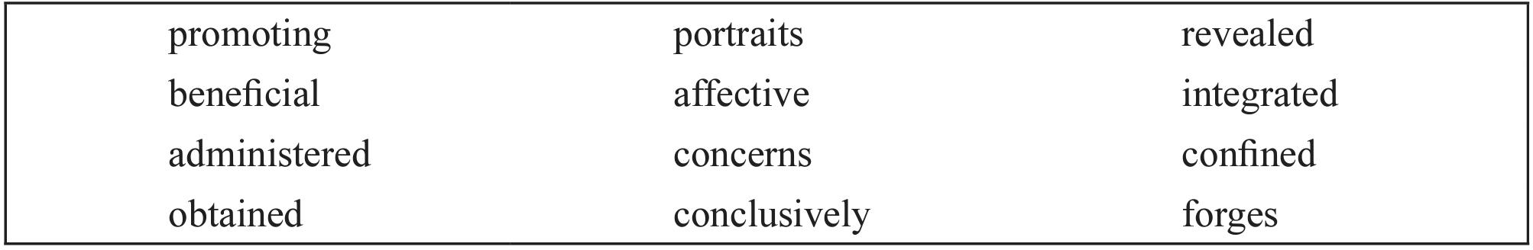
Collocation Practice
Use these words to fill in the sentences on Page 228/229

Slide 26
concerns
The portfolio process mainly deals with/ ____________ the decisions of language teachers rather than students’ perceptions of portfolios.
Portfolio keeping is helpful/ ___________ for overcoming writing anxiety.
The use of portfolios involves both teachers and students and sets up/ _________ a partnership in the learning process.
In one aspect, portfolios aid learning by providing pictures/ _____________of students.
At the end of the semester, the instructor gave/ ____________ the final examination.
An combined/ ____________ approach to learning English was well received by the students.
beneficial
forges
portraits
administered
integrated

Slide 27
promoting
7) The approach is effective in improving/ ____________students’ productive and receptive language skills.
8) Finally/ _____________, it can be highlighted that portfolios in EFL writing have positive effects.
9) The results found in the study mainly support those got/___________ from preious studies.
10) The present study showed/____________ that during the portfolio keeping process, students do not experience anxiety.
11) The scope of the study was limited/___________ to the descriptive data obtained from the questionnaires.
12) Further research should focus on the relationships between EFL students’ perceptions of portfolio keeping and some independent variables such as demographic factors, emotional/__________ states, and motivational issues.
Conclusively
obtained
revealed
confined
affective

Slide 28
Collocations
What do you notice about the new words compared to the words being replaced?

Slide 29
Using Conjunctions

Slide 30
What is wrong with these sentences?
Turned on the blue light.
The grey cat and the brown mouse.

Slide 31
Sentence Rules Review
To be a sentence, a sentence must have:
a verb
a subject (Noun/Pronoun)

Slide 32
Simple Sentences (Independent Clause)
A subject, one main verb, and a complete thought:
I am a sentence.
He sleeps.
The Grey Warden and her companions tracked the great Darkspawn army to Ostagar.

Slide 33
Another example: A declarative Sentence parade
It was hotter than Hamish thought it could get. It was 125°F in the shade. Sand blew across the highway. Hamish rode shotgun with Briscoe. Briscoe peered over the wheel.
“The problem is that this unvaried structure quickly creates a cadence that echoes in the reader’s head, and it’s like a death march, trudging its way forward with relentless persistence.”

Slide 34
But Remember: Avoid Comma Splices
I was hungry, I ate lunch.
When we use a comma to join two simple sentences (called independent clauses inside a larger sentence) this is called a comma splice, and is a mistake.

Slide 35
Avoiding Comma Splices
I was hungry, I ate lunch.
I was hungry and I ate lunch.
I was hungry so I ate lunch.
I was hungry; I ate lunch.

Slide 36
Compound and Complex Sentences
To properly join clauses together, we use conjunctions or semicolons (;)
There are two different kinds of conjunctions: coordinating conjunction and subordinate conjunctions
We must also not start sentences with conjunctions in academic register

Slide 37
Joined simple Sentences
I looked but I didn’t see him.
I looked, although I didn’t see him.

Slide 38
Starting Sentences With Conjunctions
Conjunctions are meant to join two clauses together in a sentence – it is strange to have a simple sentence starting with a conjunction, since we expect another clause.
And this is only half a sentence. But where is the other half?

Slide 39
The types of conjunctions
Coordinating Conjunctions:
Either…Or, Both…And
“FANBOYS”
Subordinating Conjunctions:
Although, Even though, As soon as, Before, Until, Since, After…

Slide 40
The Coordinating Conjunctions
F | For
A | And
N | Nor
B | But
O | Or
Y | Yet
S | So
(Both)
(Neither)
(Either)

Slide 41
Clauses + Coordinating Conjunction = Compound
A compound sentence is made from two equal independent clauses joined with a coordinating conjunction.
An independent clause can be a short sentence on its own.

Slide 42
Clauses + subordinating Conjunction = complex
A complex sentence is made from an independent clause and a dependent clause, usually joined with a subordinating conjunction or relative pronoun (who, which, that, etc.)
A dependent clause is a sentence that cannot exist alone – it needs another idea to complete it.

Slide 43
Subordinating Conjunctions
after
although
as
because
before
even though
if
since
though
unless
until
when
whenever
whereas
wherever
while

Slide 44
Some Considerations for Introduction

Slide 45
Present Perfect – Describing Background
In the Introduction we often describe the background to a field or research area, describing past research
While past tenses are useful here, another verb tense than can prove very useful is the present perfect tense
We use the present perfect to talk about events in the past that have an influence or connection to the present
Using present perfect as opposed to past simple highlights the relationship to the present, and its relevance to your study

Slide 46
Examples
A study has been conducted in this field.
Some of these questions have been investigated before.
This particular question has not yet been addressed.

Slide 47
Introduction: Starting sentence
The introduction starts general – but you don’t want to be TOO general, focus on your topic right away
Avoid: Nowadays, technology is improving
Avoid: The development of social media is attracting a lot of attention
Also introduce your topic first, not the popularity of your topic
E.g. avoid : “There is a lot of literature/past research/etc on…”
Also avoid telling people what to do (save it for move 3 in the discussion)

Slide 48
Introduction: Moves 2 and 3
Stating a gap in the literature is important, but you want to be diplomatic about it
Remember that the people who will be editing your future research are very likely the people who you cited in your literature
If you insult their work, they will not give you good reviews and you cannot publish

Slide 49
Introduction: Moves 2 and 3
Avoid criticizing your sources in your literature review
E.g. “The past literature was not empirical enough” “The researchers ignored the feelings/couldn’t understand the participants”
Better: “We are looking for a more objective measurement” or “No research has used unstructured qualitative measurements”

Slide 50
Review: In-text Citation Formatting

Slide 51
APA in text citations
In text citations use the parenthetical author-date method
Author’s name first, followed by the year of publication, in parenthesese ()
(Smith, 2009)
You never put the author’s first name in an in-text citation – you only include the first initial if there is more than one author with the same last name and you need to distinguish them

Slide 52
APA in text citations
The same goes when you introduce the source with a signal phrase:
According to Smith (2009),
Smith (2009) found
The date should go right after the author’s last name
The same goes when using et. al.
According to Smith et. al. (2010),
When referencing existing research, APA requires signal phrases to use Past or Present Perfect tense (found/ has found)

Slide 53
The “et. al.” format
For two authors, include both:
(Smith & Doe, 2009)
For three/four or more authors, include just the first author followed by “et al”:
(Smith et al., 2009)
Not (Smith & Jones & Johnson, 2009)
Unless the authors have multiple publications from the same year, include the second
Smith, Doe, and Jones (2009) → (Smith, Doe, et al., 2009)
Smith, Liu, and Wang (2009) → (Smith, Liu, et al., 2009)

Slide 54
Direct quotes
If you are quoting directly from the source and use a signal phrase, the page number must be at the end of the quote:
According to Smith (2009), “….” (p. 100)
Smith (2009) found “…” (p. 100)
Otherwise page numbers are included in the citation
She stated “….” (Smith, 2009, p. 100).
Quotes must have page numbers!
Same as before, signal phrases use Past or Present Perfect tense (found/ has found)

Slide 55
Quotation Example From Textbook
Online sources, then, become a resource tool where the main purpose can be “to prevent or at least reduce communication conflicts which may arise from lexical deficit” (Hartmann, 1987, p. 21).
Exact words
Citation
w/ Page #
Quotation marks
Page 82

Slide 56
Not all sentences are quotations
“The sky is blue” – Smith (2009)
The sky is blue (Smith, 2009)
Smith (2009) said that the sky was blue

Slide 57
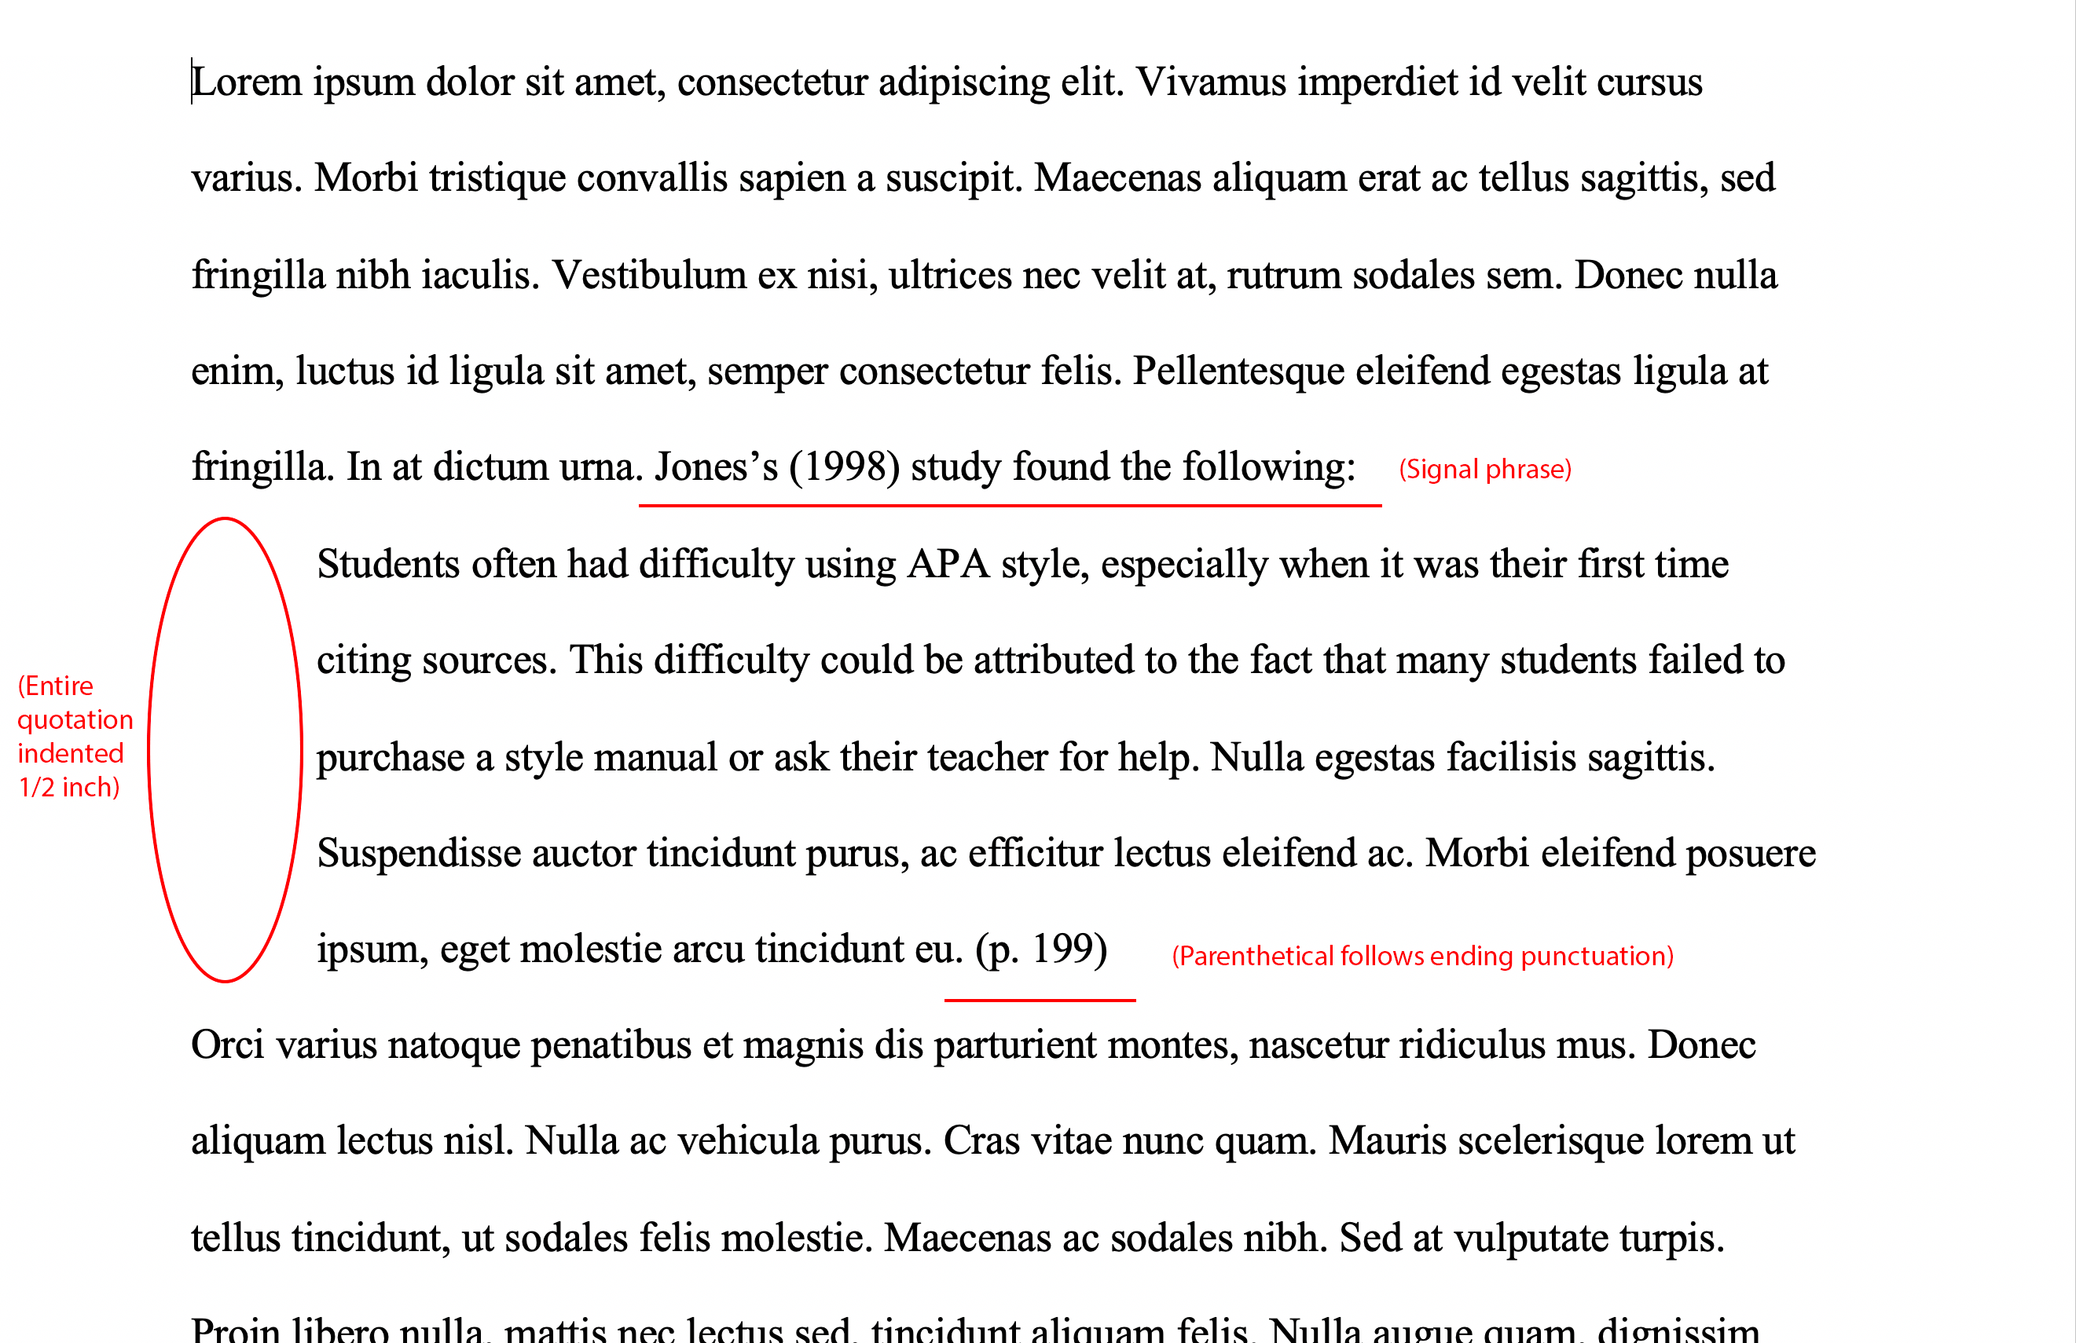
APA in text citations
Long quotations (especially more than two setences) are indented on a separate paragraph with ½ inch margins
Page numbers are still a must

Slide 58
Reference Lists

Slide 59
Points to Remember for Reference Lists
The list should be in alphabetical order by first word of each entry (last name of author/editor, organization name, etc.). For the same name, organize by date (earliest to latest)
Only include last names and initials – not full names
Write up to 20 authors. If there are more than 21 authors, use “…” after 19th author and write the final author in the list
Entries do not need to be numbered

Slide 60
APA reference list
Basic rules:
Title of article follows author
Journal name follows article
Capitalize all major words in journal names
Journal names are italicized, article titles are not

Slide 61
APA reference list: Articles
Basic form:
Author, A. A., Author, B. B., & Author, C. C. (Year). Title of article. Title of Periodical, volume number(issue number), pages. https://doi.org/xx.xxx/yyyy
Magazines and newspaper titles can replace the periodical title

Slide 62
APA reference list
Single author:
Smith, J. (2009). Citing references in research. Journal of Research, 1(1), 100-200.
Two authors:
Smith, J. & Doe, J. (2009). Citing references in research. Journal of Research, 1(1), 100-200.
Group author:
Merriam-Webster. (2008). Braggadocio. In Merriam-Webster’s Advanced Learner’s English Dictionary. Merriam-Webster.

Slide 63
APA reference list
If the author appears in two references, list the single reference first
For more than one single reference, organize by date
Organize the references based on alphabetical order of second author
Smith, J. (2009). Citing references. Journal of Research, 1, 100-200. Smith, J. (2010). Citing references again. Journal of Research, 1, 100-200. Smith, J. & Johnson, R. (2007). Citing more references. Journal of Research, 1, 100-200. Smith, J. & Wang, R. (2007). Citing so many references. Journal of Research, 1, 100-200.

Slide 64
APA reference list
Titles in italics
Books:
Author, A. A. (Year of publication). Title of work: Capital letter also for subtitle. Publisher Name. DOI (if available)
Smith, J. (2009). Citing references: All the rules. Yale University Press.
Edited book:
Author, A. A. (Year of publication). Title of work: Capital letter also for subtitle (E. Editor, Ed.). Publisher. DOI (if available)
Smith, J. (2009). Citing references: All the rules. (J. Doe, Ed.). Yale University Press.

Slide 65
APA Reference List Sources: Electronic
Online periodical
Bernstein, M. (2002). 10 tips on writing the living Web. A list apart: For people who make websites, 149. Retrieved from http://www.alistapart.com/articles/ writeliving
Same as journal, but include link

Slide 66
APA Format for Foreign Language Sources
Author(s) - last name, initials. (Year). Article title in original language [English translation of article title]. Journal name - italicised, volume - italicised(Issue - if available. Not italicised), Page(s). DOI or Web address - if available
For sources that use other alphabets, transliterate (in Chinese, Pinyin) the title, as we are not to use other alphabets in APA style
Names should still be last name, initials

Slide 67
Use normal format, but add translated title after transliterated one
Najm, Y. (1966). Al-qissah fi al-adab Al-Arabi al-hadith [The novel in modern Arabic literature]. Dar Al-Thaqafah.
Ministry of Foreign Affairs. (1997, June 12). Peru jiken chosa iinkai no hokoku ni tsuite no Ikeda Gaimu Daijin no kishakaiken [Press interview with Foreign Minister Ikeda on the report of the investigation committee on the Peru Incident]. Ministry of Foreign Affairs of Japan. Retrieved from http://www.mofa.go.jp/mofaj/gaiko/hoka/peru/ index.html

Slide 68
Task 1
On Page 236 are some citations from a reference list/ bibliography
Identify which type of source each one is based on the citation format.

Slide 69
Evans, V., & Melanie, G. (2006).Cognitive Linguistics: An Introduction. Edinburgh: Edinburgh University Press.
( )
Stern, B. (1997, March). Rising to the challenge. Canadian Living, pp. 68–71.
( )
Wallace, A. (n.d.). The new cost of the old economy. Retrieved from http://www. quarryinstitute.org/articles/quarry.htm
( )
Harrison, B. K. (2003). Mummy’s curses: Methods of identifying, tracking, and categorizing. The Interlake Egyptologist, 7(8), 17–22.
( )
Schwartz, J. (2005, February 13). Are organic vegetables really better for you? The Gazette, p. D6. Retrieved February 25, 2005, from Proquest database.
( )

Slide 70
Evans, V., & Melanie, G. (2006).Cognitive Linguistics: An Introduction. Edinburgh: Edinburgh University Press.
(book)
Stern, B. (1997, March). Rising to the challenge. Canadian Living, pp. 68–71.
(magazine article)
Wallace, A. (n.d.). The new cost of the old economy. Retrieved from http://www. quarryinstitute.org/articles/quarry.htm
(website)
Harrison, B. K. (2003). Mummy’s curses: Methods of identifying, tracking, and categorizing. The Interlake Egyptologist, 7(8), 17–22.
(journal article)
Schwartz, J. (2005, February 13). Are organic vegetables really better for you? The Gazette, p. D6. Retrieved February 25, 2005, from Proquest database.
(newspaper article)

Slide 71
Reference List Formatting
Apart from the order, there are some formatting tips that can make the list much easier to read for the reader
APA style still applies: 12-point font and double-spacing
You want to use “hanging” indentation so that the list has clear entries that are easy to distinguish

Slide 72
Without indentation, this list is hard to read
Boyden-Knudsen, T. (2001). The effects of analytic corrections and revisions on college composition students in a portfolio assessment setting. Paper presented at the Annual Meeting of the American Educational Research Association, Seattle, WA. Burksaitiene, N., & Tereseviciene, M. (2008). Integrating alternative learning and assessment in a course of English for law students. Assessment and Evaluation in Higher Education, 33(2), 155–166. Chang, Y., Wu, C., & Ku, H. (2005). The introduction of electronic portfolios to teach and assess English as a foreign language. TechTrends: Linking Research and Practice to Improve Learning, 49(1), 30–35. Cohen, D. (1994). Assessing language ability in the classroom. Boston: Heinle & Heinle. Delett, J. S., Barnhardt, S., & Kevorldan, J. A. (2001). A framework for portfolio assessment in the foreign language classroom. Foreign Language Annals, 34(6), 559–568.

Slide 73
Adding indentation so the first line overhangs makes each one clear and easy to distinguish
Boyden-Knudsen, T. (2001). The effects of analytic corrections and revisions on college composition students in a portfolio assessment setting. Paper presented at the Annual Meeting of the American Educational Research Association, Seattle, WA.
Burksaitiene, N., & Tereseviciene, M. (2008). Integrating alternative learning and assessment in a course of English for law students. Assessment and Evaluation in Higher Education, 33(2), 155–166.
Chang, Y., Wu, C., & Ku, H. (2005). The introduction of electronic portfolios to teach and assess English as a foreign language. TechTrends: Linking Research and Practice to Improve Learning, 49(1), 30–35.
Cohen, D. (1994). Assessing language ability in the classroom. Boston: Heinle & Heinle.
Delett, J. S., Barnhardt, S., & Kevorldan, J. A. (2001). A framework for portfolio assessment in the foreign language classroom. Foreign Language Annals, 34(6), 559–568.

Slide 74
Task 2 (Page 236)
Each one of the entries on Page 236/237 has an error.
Use the information in the book and online to find and correct the error.

Slide 75
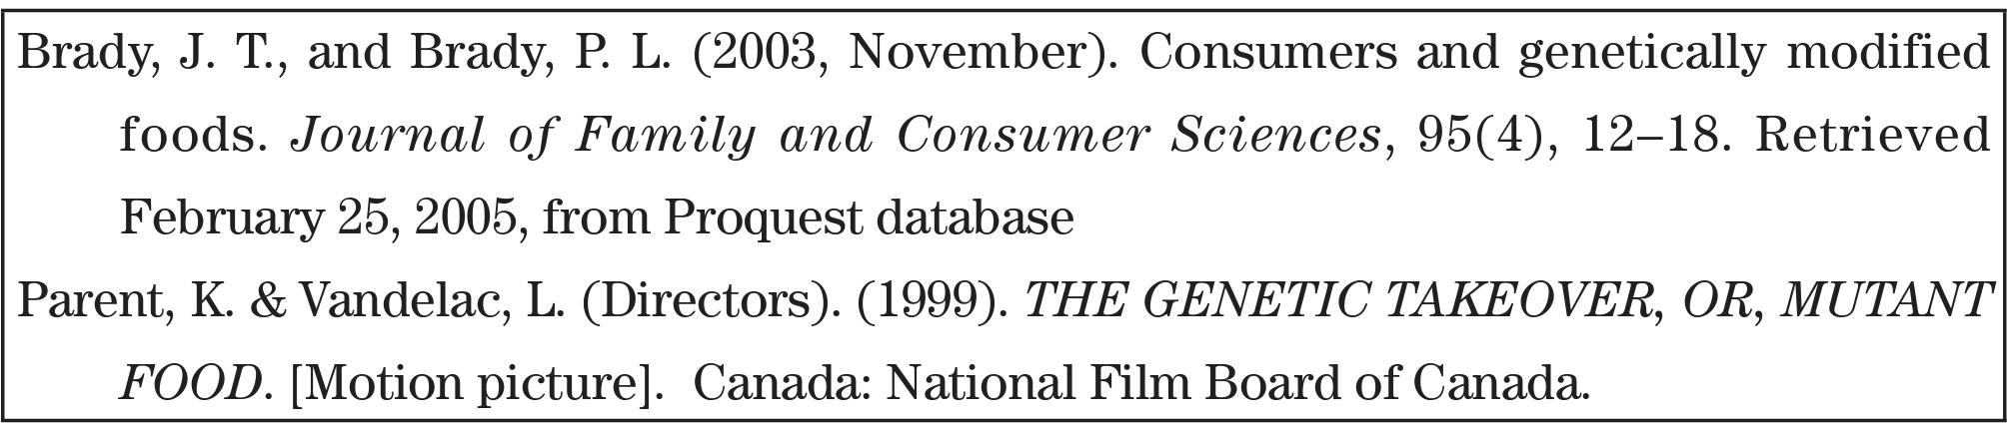

Slide 76
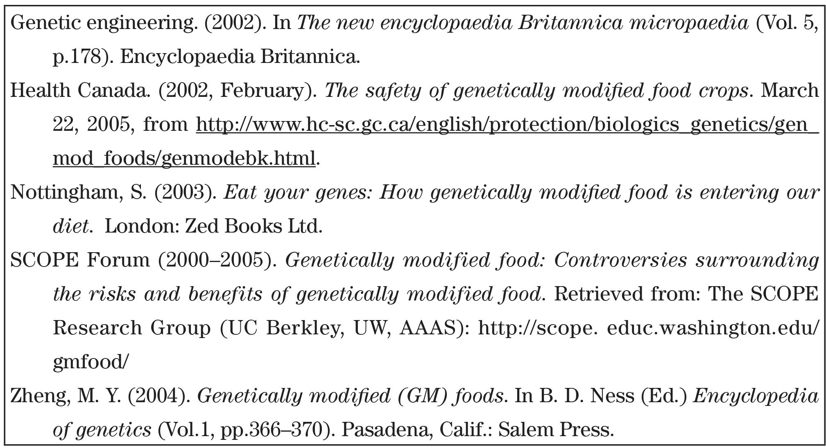

Slide 77
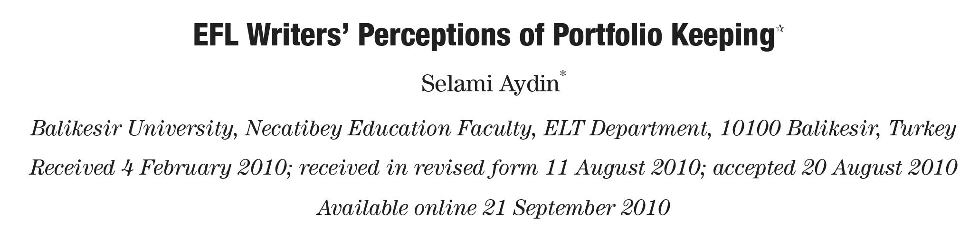
Reading practice

Slide 78
Abstract:
Although portfolios in writing in English as a Foreign Language (EFL) learning are alternative tools, the portfolio process mainly concerns the decisions of language teachers rather than students’ perceptions of portfolios. The present study aims to descriptively measure the perceptions of English as a Foreign Language (EFL) students towards portfolio keeping. The sample group in the study consisted of 204 EFL students. A portfolio contribution questionnaire and a portfolio problem questionnaire were used to collect quantitative data. Two results were obtained from the study: (1) portfolio keeping in EFL writing is beneficial to the improvement of vocabulary and grammar knowledge, reading, research, and writing skills; and (2) EFL students perceive some problems during the portfolio keeping process.
Keywords: English as a Foreign Language; EFL; writing; portfolio; students’ perceptions
Page 214

Slide 79
Questions
According to what we learned before, does this abstract make any formatting mistakes?
Based on this abstract, can we tell what the research question/research aim is? Which methods were used?
What are the main findings/conclusion of this paper?

Slide 80
Next Week
There will be an optional quiz on Unit 7 – you do not need to take it if you do not want to, but it will replace the lowest existing quiz mark
There will only be a review+quiz and a chance to ask final questions
The final paper will be done at the end of term (Note: you don’t need an abstract, just a title page)

